Slide 1
NUMBERS IN ENGLISH

Slide 2
There are two types of numbers. They are cardinal numbers and ordinal numbers. Each of them are used in specific situations.
Cardinal numbers: They are use to say how many people or things are in place.
Ordinal numbers: They are used to indicate the position of something in a list.

Slide 3
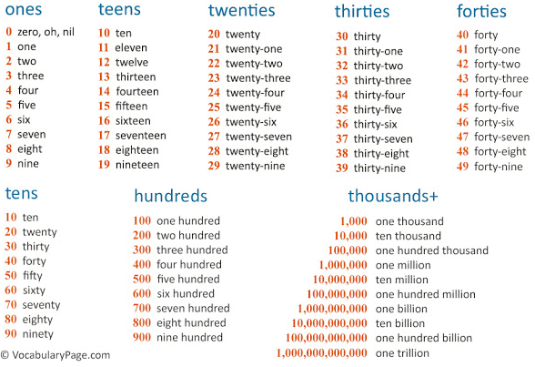
Cardinal numbers

Slide 4
One hundred nineteen
One thousand one hundred nineteen
1.000.119 one million one hundred nineteen
100.000 one hundred thousand

Slide 5
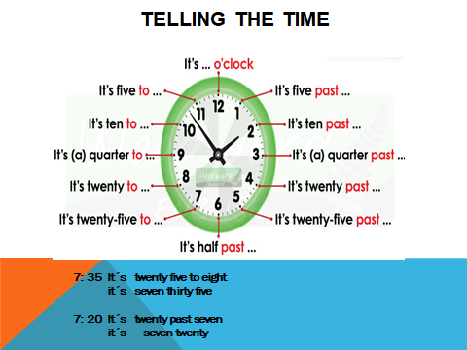

Slide 6
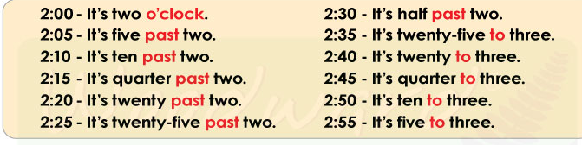
KEY VOCABULARY
What time is it? = Que hora es?
It´s ….= Son las…
O´clock = en punto
quarter past = un cuarto pasadas las…
quarter to = un cuarto para las …
Half past = media pasadas las …
For hours like 2:05 you can also use only numbers.
Example It´s two five

Slide 7
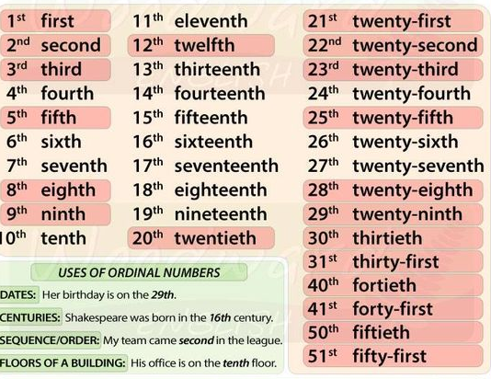
Ordinal numbers

Slide 8
Exercises
1. Write the following numbers in English
458
3.965
145.870
1.246.763
2. Complete with the correct ordinal number
1. She's sitting in the _____ row. (1)
2. They are celebrating their _____ anniversary. (25)
3. The old man died on his ______ birthday. (88)
4. That was my ______ accident this month. (2)
5. My house is the ______ on the right. (3)

